Slide 1
PET SHOP MANAGEMENT SYSTEM
Hope Foundation’s Finolex Acadamy of Management & Technology
Ratnagiri
A Project Report on
Carried out by student of MCA :
MR. Nitant naresh Deulkar
MR. Om Rajesh Awasare
MR. Chandan bhagwan Howale
Project Guide : Prof. Kishore Bhosale

Slide 2
Introduction
The "Pet Shop Management System" is a straightforward Java standalone application for the efficient management of offline pet shops.
This project serves as a practical system for overseeing various aspects of a pet shop, offering a user-friendly solution for both individuals and businesses involved in pet retail.
The system streamlines the process of managing pet inventory, ensuring that products are readily available.

Slide 3
objective
The objective of the Pet Shop Management System, a Java standalone application for managing offline pet shops, is to provide a convenient and efficient platform for Pet Shop to access and obtain a wide range of pets and pet-related products, users, customers, and generate bill.
The system aims to simplify the process of finding and purchasing specific pets and products, catering to various breeds and categories. It strives to offer a diverse inventory, ensuring users can easily locate the right pets and accessories.

Slide 4
Goals of project
Engaging splash screen during loading for a professional introduction.
Secure login system with distinct access levels for employees and admin.
Facilitates easy management of pet categories, such as pet types and accessories.
Dedicated section for managing customer information, including updates and deletions.
Automates invoice generation based on customer purchases.
Securely ends user sessions for data privacy.

Slide 5
Need of system
There is always a need of system that will perform management of pets, its category, users , customers , billing , and return records.
This system will reduce the manual operation required to maintain all the records.

Slide 6
Project scope
The project has a wide scope, as it is not intended to a particular organization.
This project is going to develop generic software, which can be applied by any businesses organization.
More over it provides facility to users.

Slide 7
Proposed system
The system provides a diverse catalog of pet-related products, offering a wide array of choices that may not be readily available in local pet shops.
Pet shop owners and employees can efficiently manage pet inventory, customer information, and billing through the convenience of a standalone Java application, eliminating the need for traditional manual methods
The system features a user-friendly interface, facilitating easy navigation, product searches, and seamless transactions, making it accessible to pet shop owners with varying levels of technical expertise.

Slide 8
Modules
Admin Module :
i] Add / Update Pets.
ii] Add / Update Category.
iii]Add / Update Customer records.
iv]Add / Update Users(Staff).
v]Generate Bill.
User Module :
i] Add / Update Pets.
ii] Add / Update Category.
iii]Add / Update Customer records.
iv]Generate Bill.

Slide 9
System Environment
Front End/GUI Tools : Java (JFrame – Swing Framework)
Back End : Java
Tools & Technologies:
Xamp Server,
MySQL Queries,
Apache Netbeans IDE 18

Slide 10
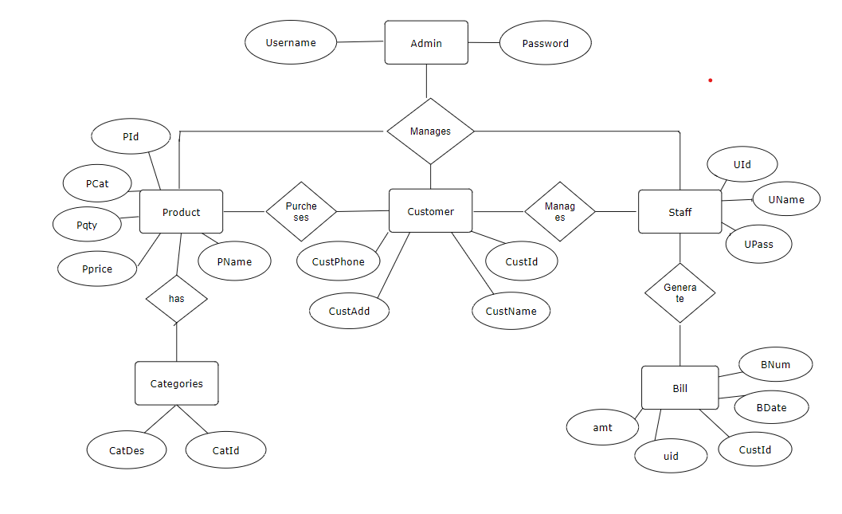
ER-DIAGRAM

Slide 11
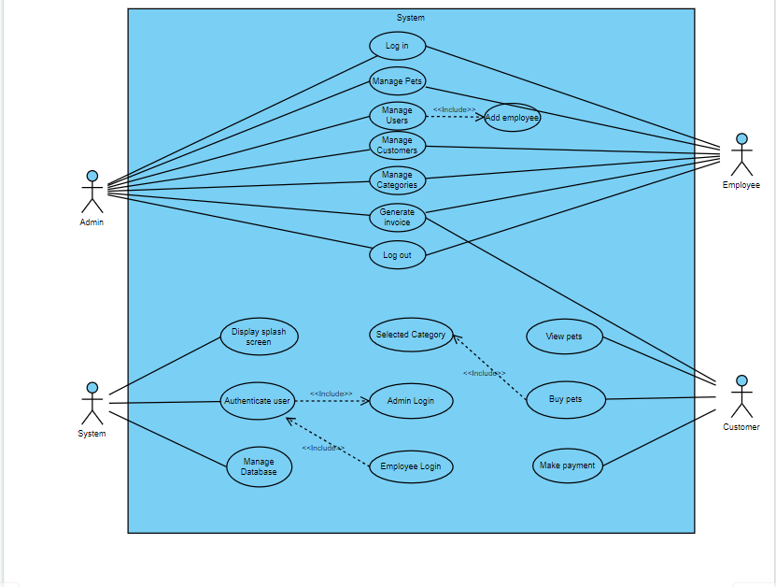
USE CASE DIAGRAM

Slide 12
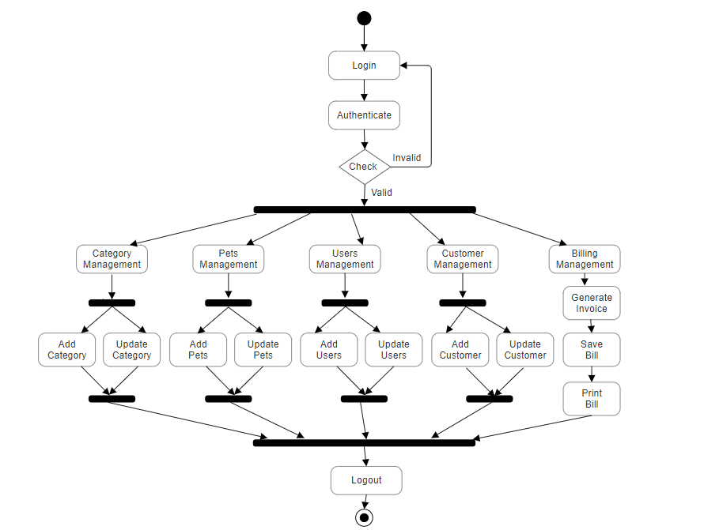
ACTIVITY DIAGRAM

Slide 13
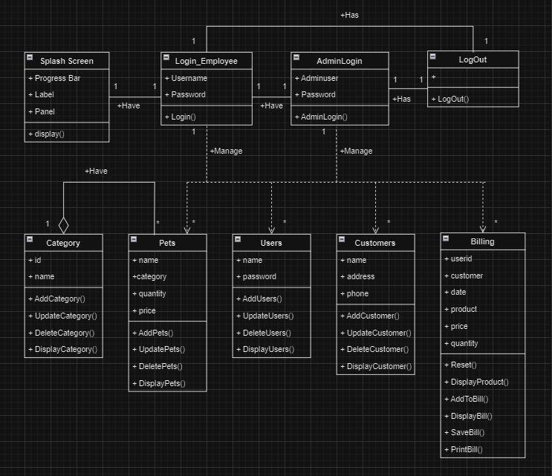
CLASS DIAGRAM

Slide 14
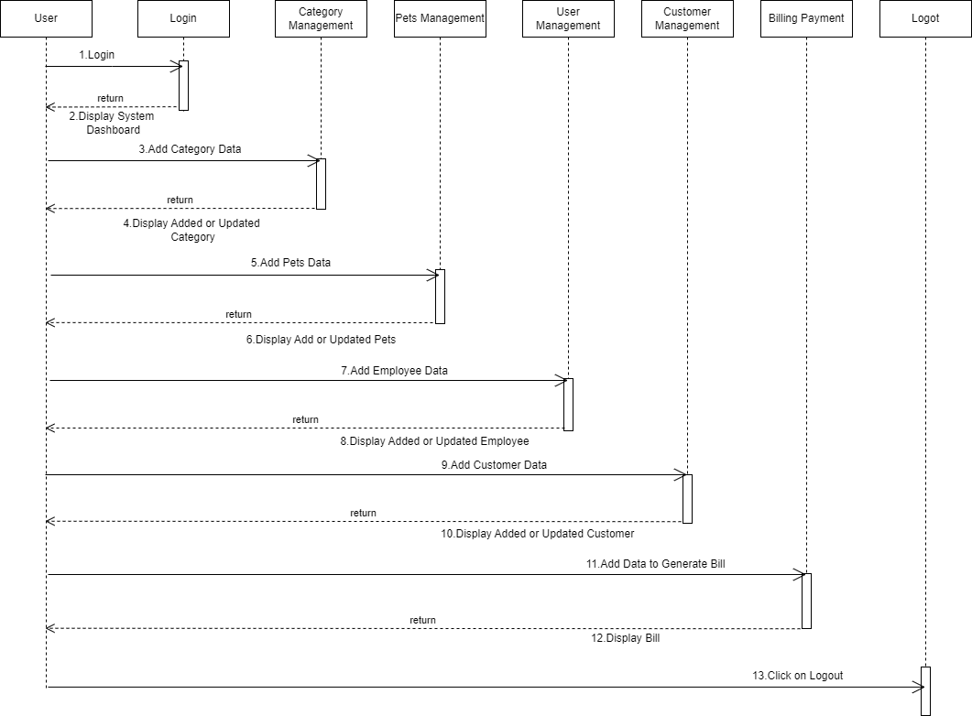
SEQUENCE DIAGRAM

Slide 15
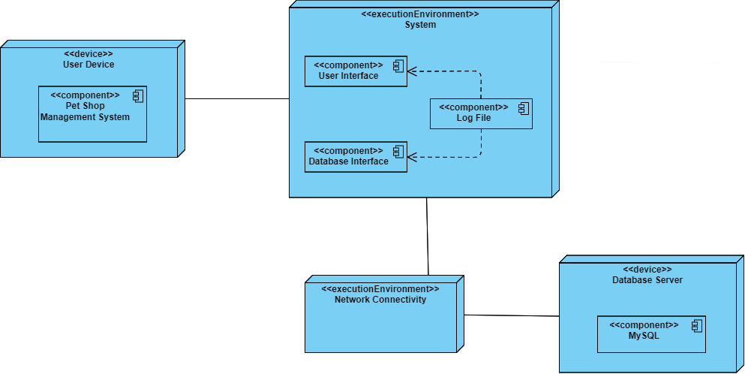
DEPLOYMENT DIAGRAM

Slide 16
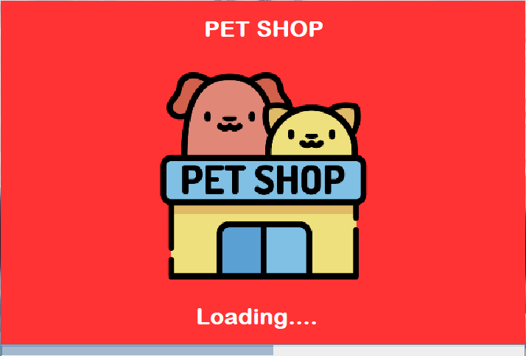
SCREENSHOTS 1. SPLASH.JAVA

Slide 17
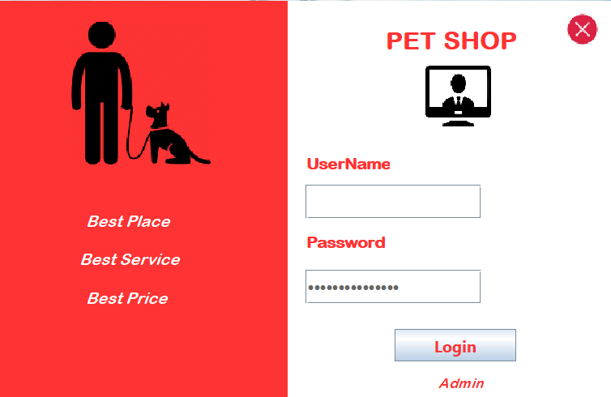
2. LOGIN.JAVA

Slide 18
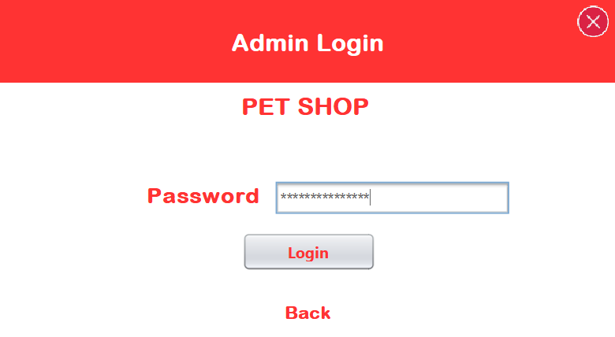
3.ADMINLOGIN.JAVA

Slide 19
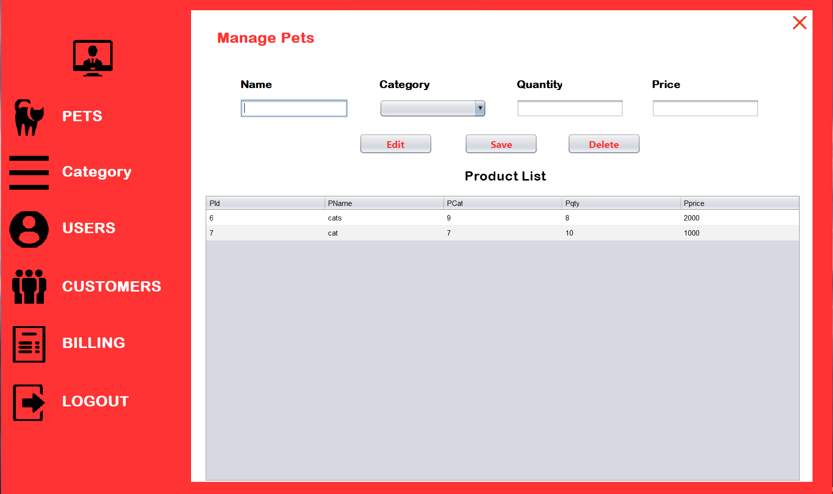
4.PETS.JAVA

Slide 20
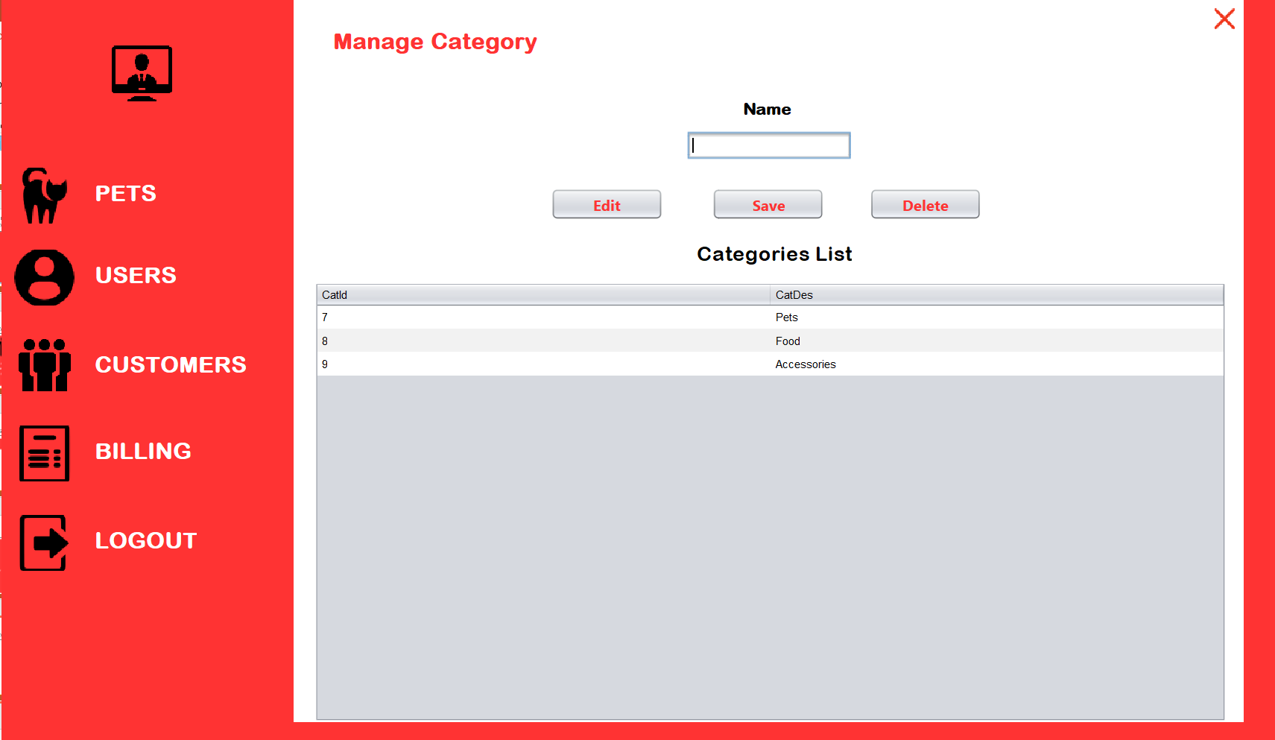
5.CATEGORY.JAVA

Slide 21
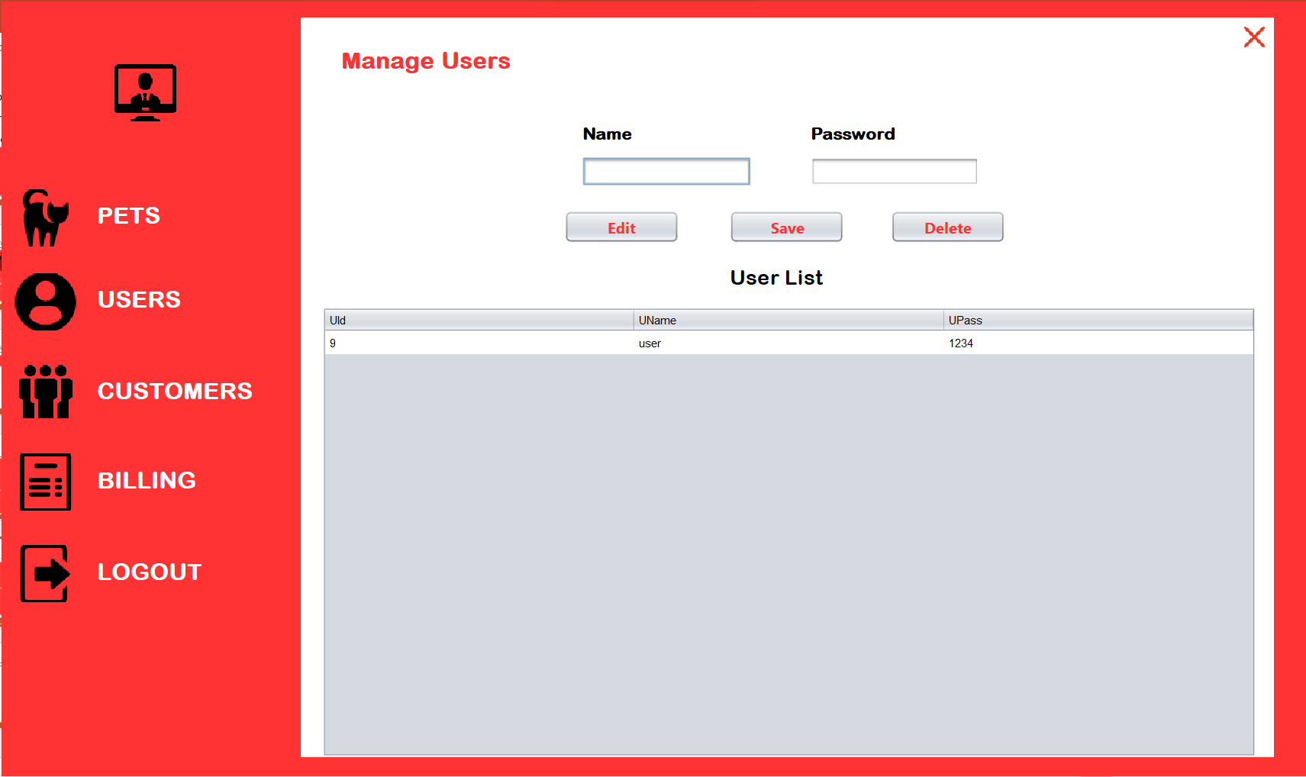
6. USERS.JAVA

Slide 22
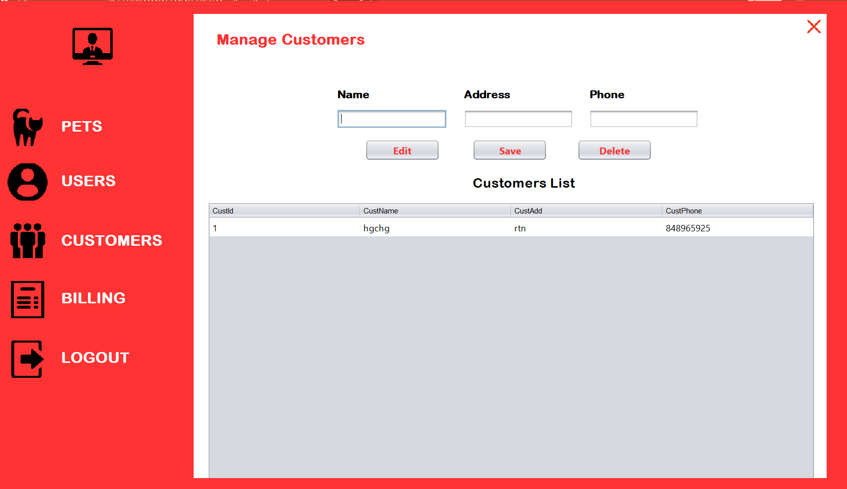
7. CUSTOMERS.JAVA

Slide 23
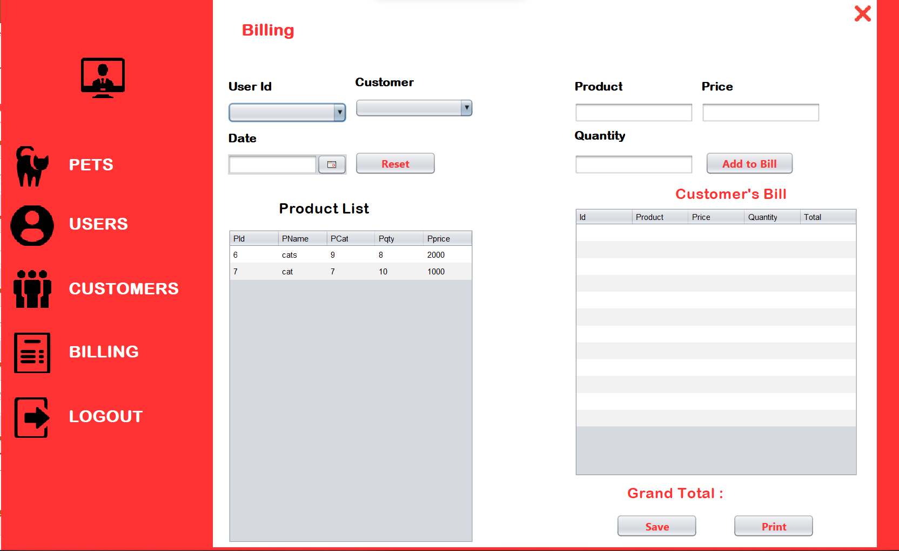
8.BILLING.JAVA

Slide 24
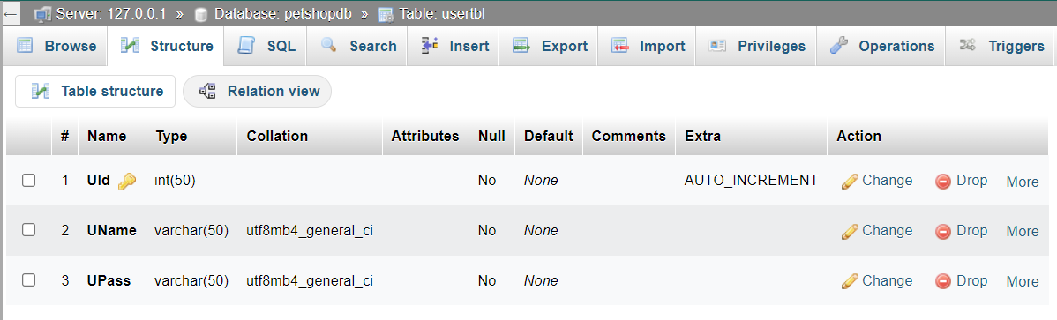
9. DATABASE
USER TABLE

Slide 25
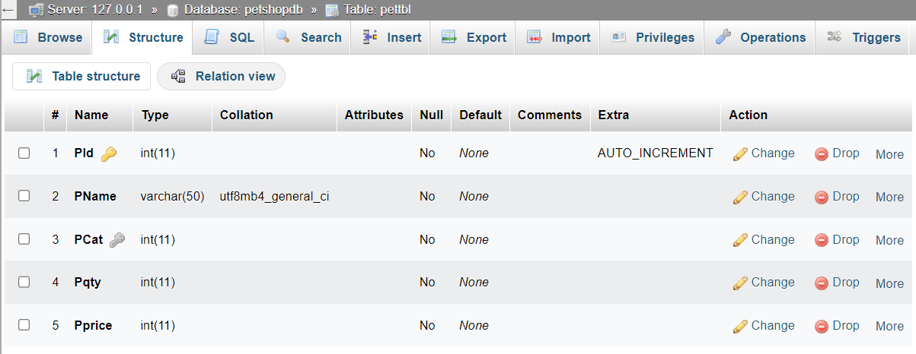
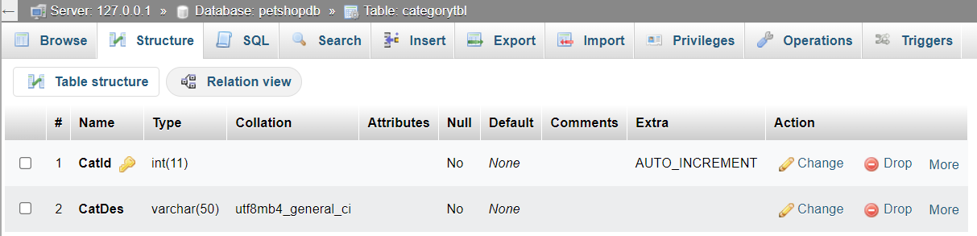
PET TABLE
CATEGORY TABLE

Slide 26
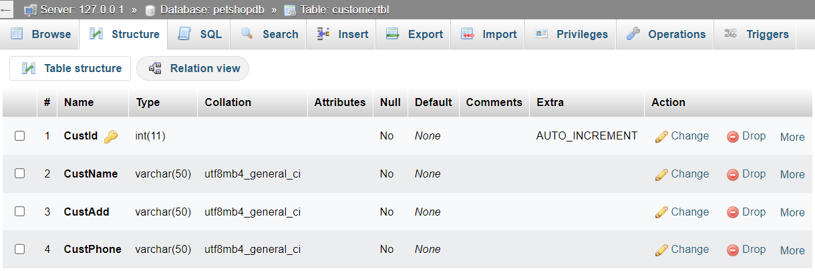
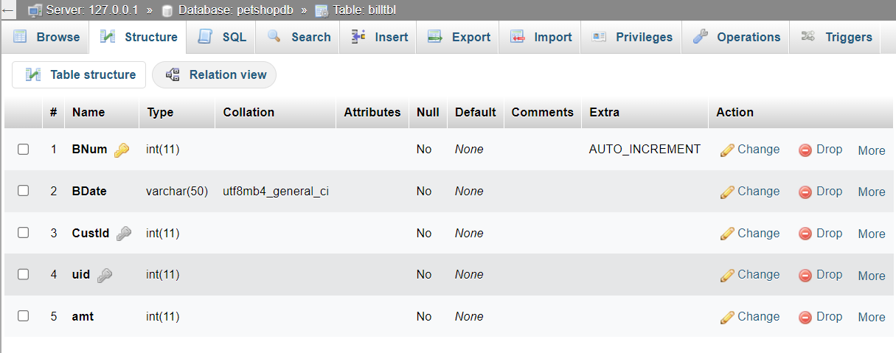
CUSTOMERS TABLE
BILLING TABLE

Slide 27
Future scope & conclusion
Future Scope –
- The project has potential for advancement, offering enhanced features and capabilities for comprehensive pet shop management.
- Future plans include hosting the platform on online servers, ensuring worldwide accessibility and facilitating seamless operations for pet shop owners.
Conclusion –
Our project is a user-friendly solution for effective pet shop management.
It aims to meet the diverse needs of pet shop operations.
The software planning framework enables timely and reasonable project estimates.

Slide 28
bibliography
www.google.com
www.youtube.com
www.javatpoint.com
www.tutorialspoint.com
https://stackoverflow.com

Slide 29
Thank you

